Slide 1
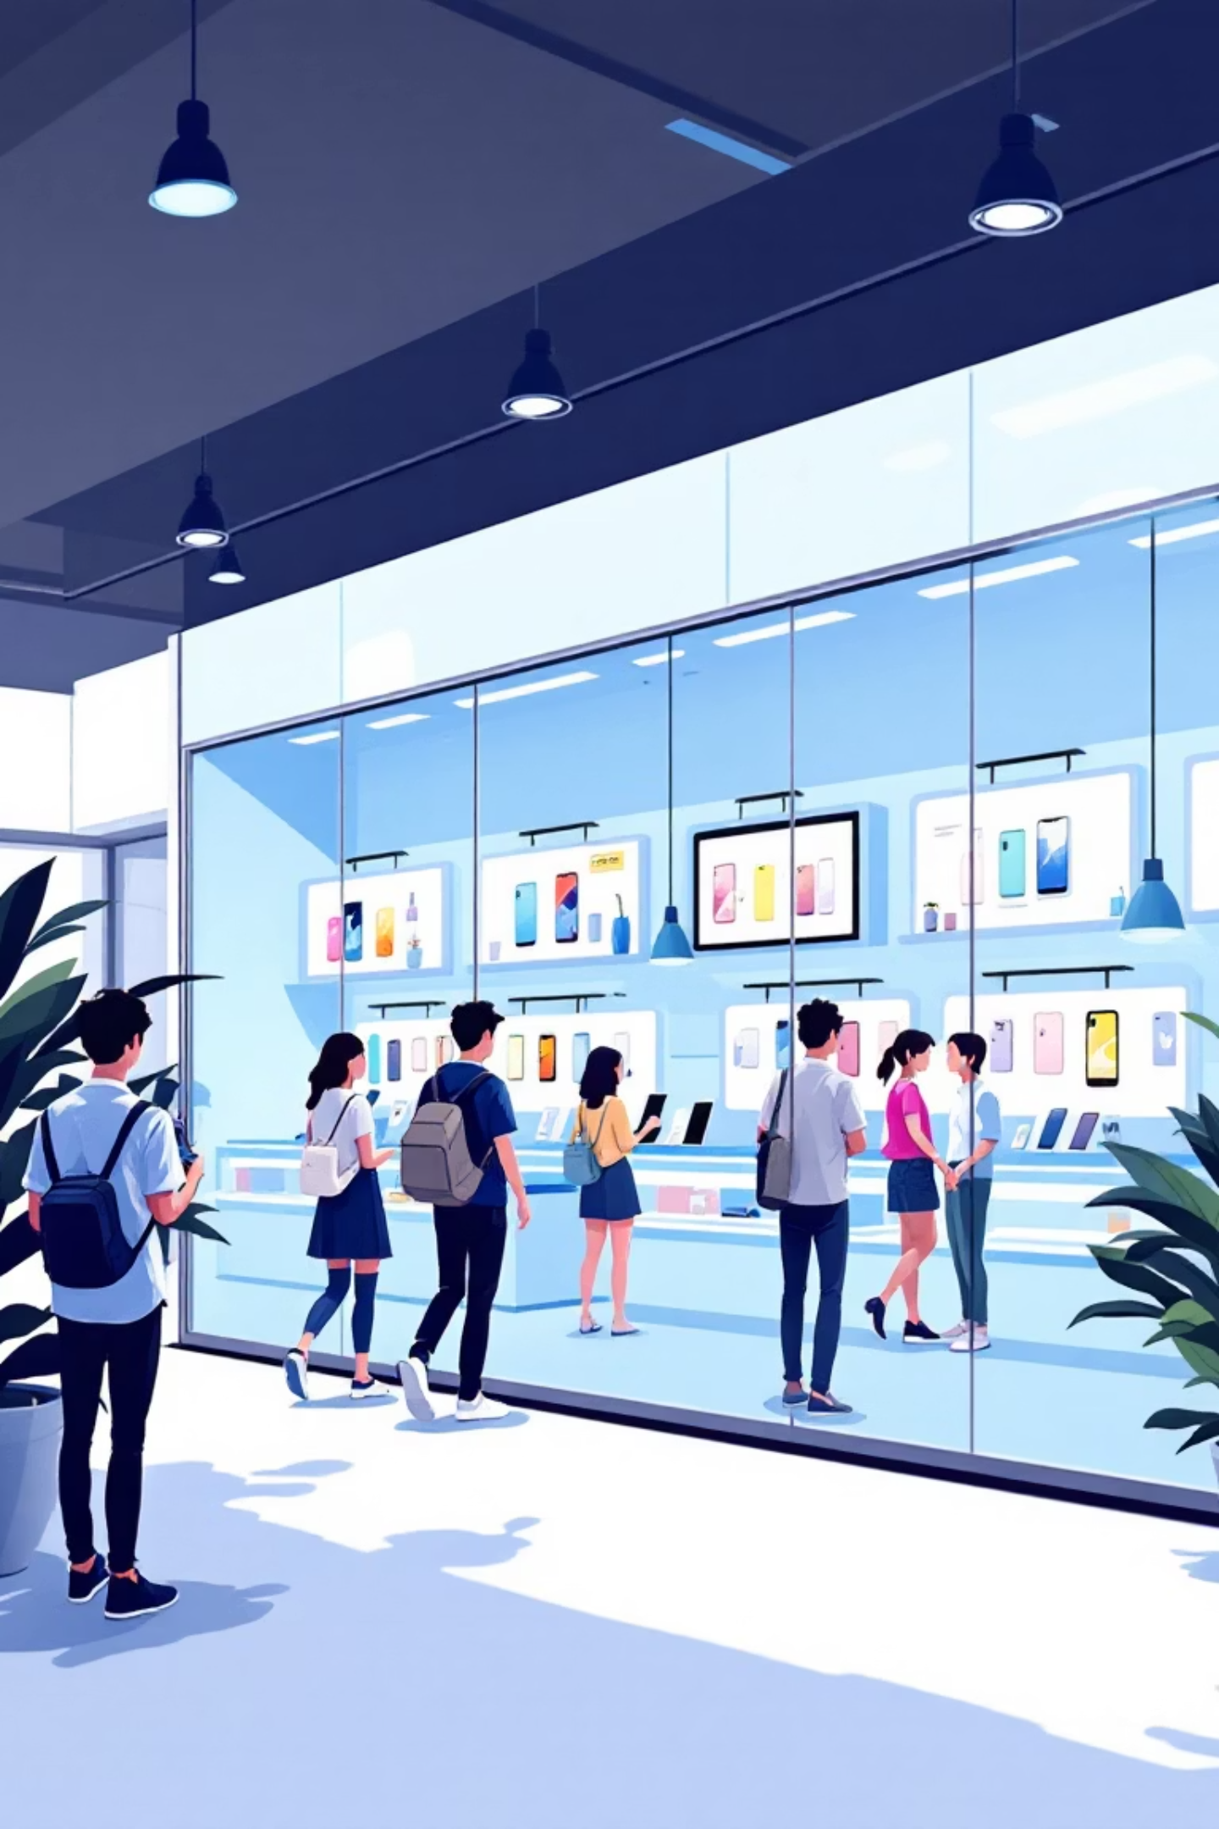
Mobile Sales Report
Annual Performance Overview 2021-2024
Motorola's comprehensive analysis of mobile sales metrics, trends, and strategic insights across brands, regions, and customer segments.

Slide 2
Executive Summary: Key Highlights
769M
19K
4K
192K
Total Sales Value
Units Sold
Transactions
Avg Transaction Value
Aggregate revenue across all transactions
Mobile devices across all brands
Total number of sales events
Per transaction average
Strong operational performance with consistent daily sales averaging 40K, demonstrating market resilience and customer demand.

Slide 3
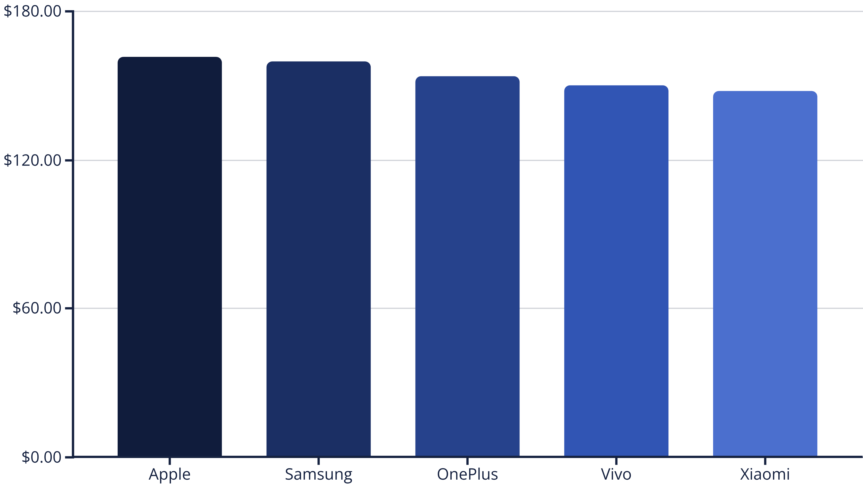
Top Brands Dominate Market
Apple leads with 21% market share, followed closely by Samsung at 20.8%. Premium brands command the market, while budget-friendly options like Xiaomi and Vivo capture significant volume.

Slide 4
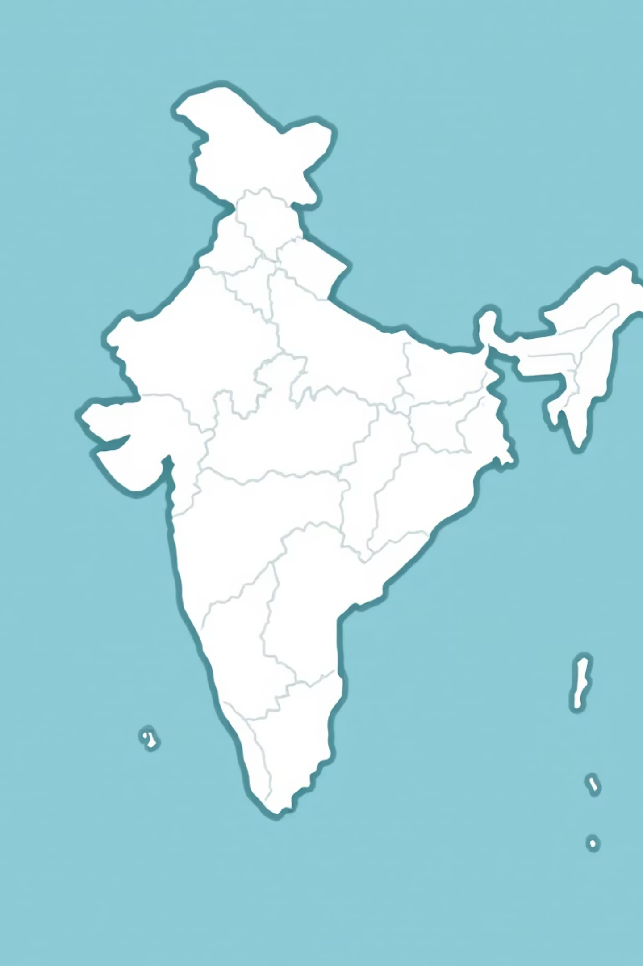
Geographic Sales Concentration
Major Cities Drive Sales: Mumbai leads as the highest sales hub, followed by Delhi with strong premium model demand. Hyderabad, Chennai, and Bangalore emerge as mid-range hotspots. Opportunity: Expand into underrepresented cities like Agra and Nashik for market growth.

Slide 5
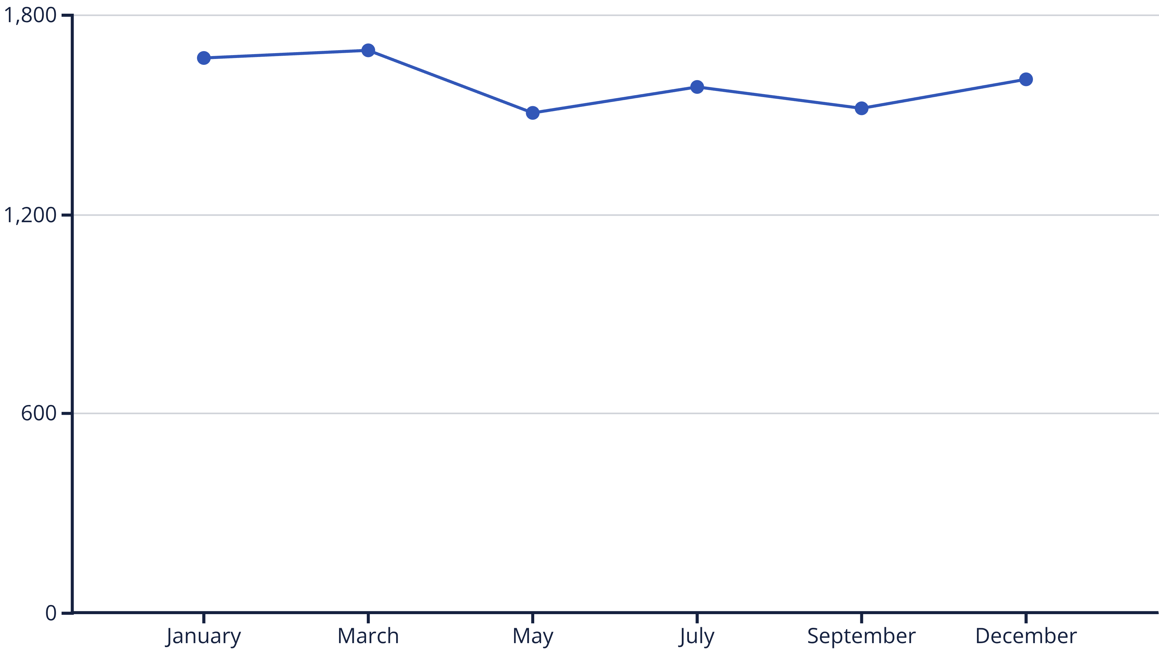
Monthly Sales Trend: Seasonal Decline
Sales quantity declined ~4% from January to December. Peak demand in January (post-holiday), with notable dips in May and September. Action: Launch mid-year promotions and back-to-school campaigns to counter seasonal decline.

Slide 6
Top Performing Models
iPhone SE
OnePlus Series
Galaxy N Series
60M in sales. Affordable entry to Apple ecosystem, driving volume.
58M in sales. Popular for performance and value proposition.
56M in sales. Strong in Android premium segment.
Mid-to-high-end models drive revenue. Budget models like Redmi Note 10 and Vivo Y51 excel in volume sales. Recommendation: Prioritize stocking top performers to maximize profitability.

Slide 7
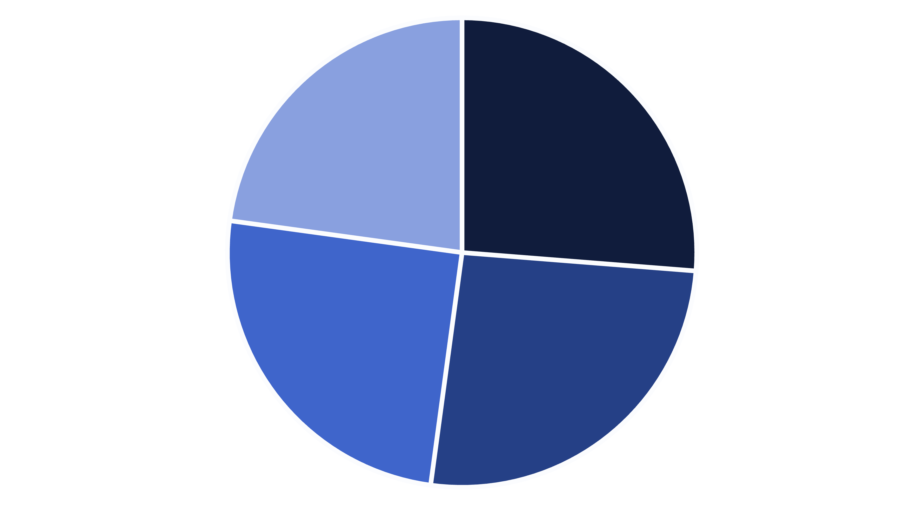
Payment Methods: Digital Dominance
Debit Card
Credit Card
Cash
UPI
Digital methods (cards + UPI) account for ~75% of transactions, aligning with India's cashless economy. Debit cards lead at 26.25%. Strategy: Partner with UPI providers for exclusive discounts to boost digital adoption and reduce cash handling costs.

Slide 8
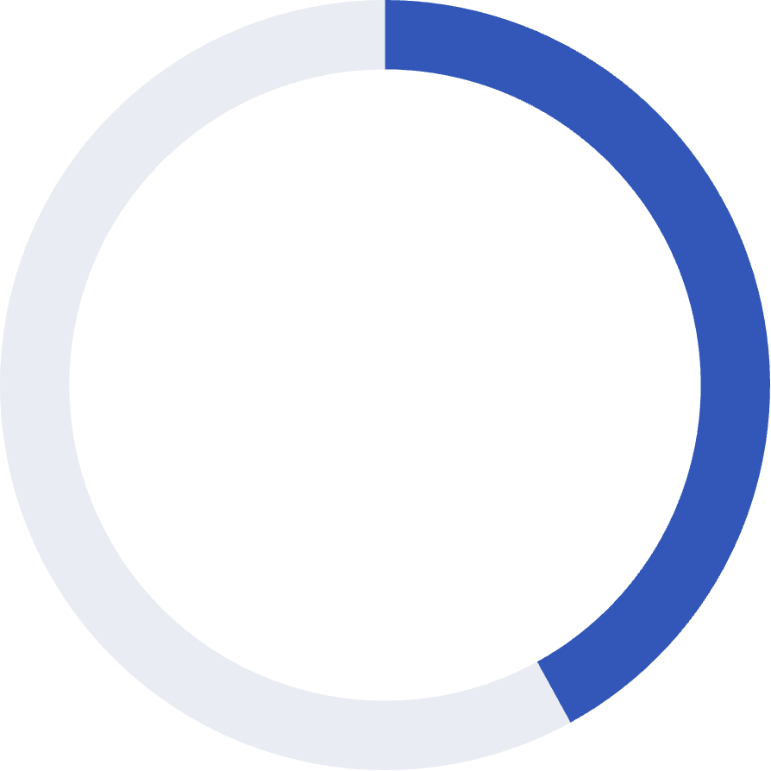
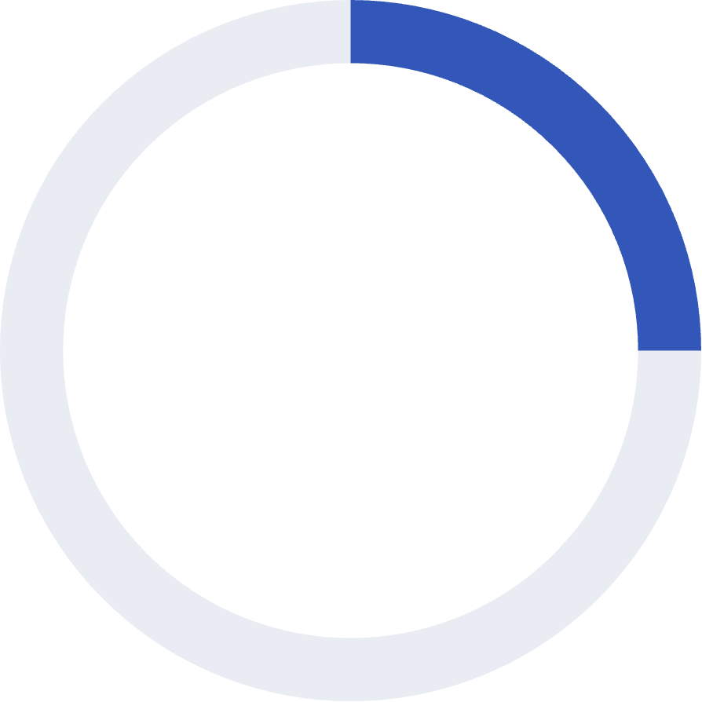
Customer Satisfaction: Strong Ratings
42%
25%
25%
5-Star Ratings
4-Star Ratings
Low Ratings (1-2)
311 instances of excellent feedback
185 positive experiences
186 instances requiring attention
Overall satisfaction is high with 67% rating 4-5 stars (average 3.75). However, 25% low ratings indicate areas for improvement in after-sales service and product quality. Action: Implement feedback loops to address common issues.

Slide 9
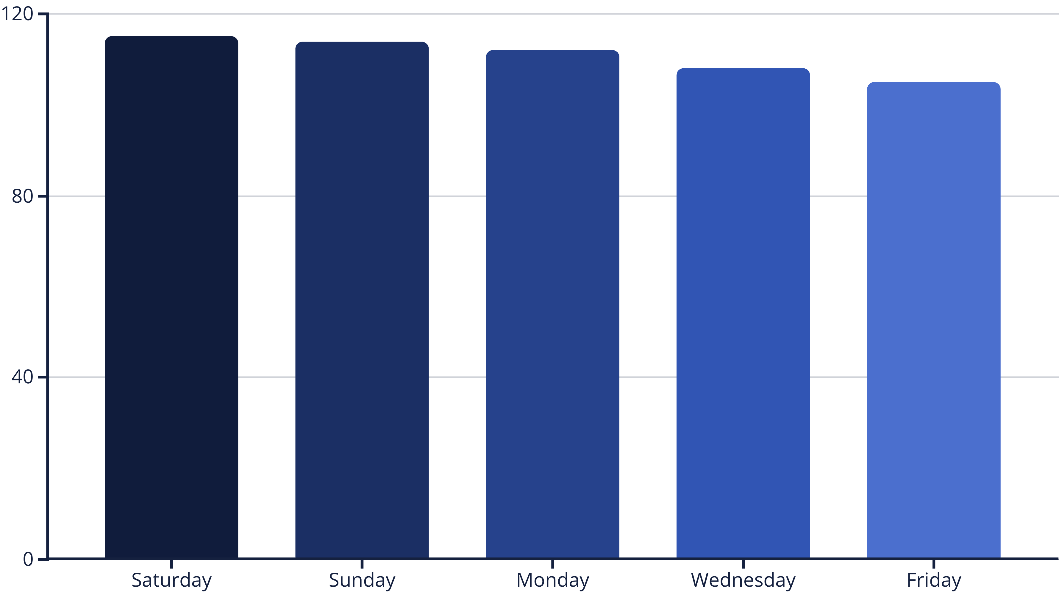
Weekend Sales Peak: Strategic Opportunity
Weekends account for ~30% of weekly sales. Saturday peaks at 115M, while Friday dips to 105M. Recommendation: Run weekend flash sales and in-store events to maximize traffic and capitalize on leisure shopping behavior.

Slide 10
Strategic Recommendations
1
Boost Seasonal Sales
Launch mid-year promotions and back-to-school campaigns to counter Q3 decline.
2
Expand Geographically
Invest in Tier-2 cities like Bhopal and Patna to diversify beyond urban hubs.
3
Enhance Digital Integration
Incentivize UPI usage to reduce cash handling and align with digital economy trends.
4
Improve Customer Experience
Address low ratings through surveys and enhanced after-sales support services.
5
Monitor Performance
Update dashboard quarterly for real-time insights and data-driven decision making.

